Slide 1
ArthaSetu
Trust Scoring for Credit-Invisible Gig Workers
PROBLEM STATEMENT
OBJECTIVE
• 190M+ Indians remain underbanked or credit-invisible
• Gig workers (delivery, ride-share, freelancers) lack formal credit history
• Informal economy workers cannot access loans, insurance, or UPI credit
• Financial illiteracy + smartphone anxiety blocks digital adoption
• SMS phishing, QR scams, social engineering target new users
• Build an adaptive trust scoring system using behavioral signals
• Use ML models on gig-economy financial data (50K records)
• Multi-language onboarding for rural/first-time users
• 10-layer post-quantum security architecture
• Sandbox UPI payments — zero real money at risk
• DPDP-2023 & RBI compliant data handling
DESIGN
🌐
👤
🧠
🔬
Multi-Language
Adaptive Profiling
Behavioral Signals
Sandbox Lab
Hindi, Tamil, Bengali, Marathi, Telugu, Kannada
Occupation-based, digital comfort level
Quiz scores, task completion, app usage
UPI, budgeting, fraud detection — zero risk

Slide 2
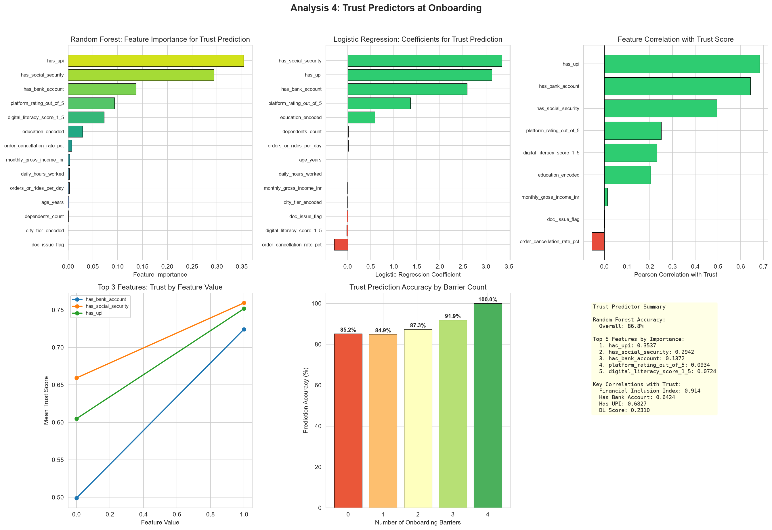
MODELS & EDA
Statistical Models & Exploratory Data Analysis
MODEL PERFORMANCE
KEY EDA FINDINGS
Model | ROC-AUC | Accuracy | F1-Score
Logistic Regression | 0.9983 | 98.5% | 0.985
Random Forest | 0.9994 | 99.1% | 0.991
Gradient Boosting | 0.9997 | 99.3% | 0.993
XGBoost | 0.9999 | 99.5% | 0.995
All models trained on 50K records, 67 features. XGBoost selected as champion.
Hypothesis Tests (p < 0.001)
• Income ↔ Loan Approval: χ²=847.3
• Credit Score ↔ Approval: t=45.6 • Employment Type ↔ Approval: χ²=1203.1 • Digital Literacy ↔ Approval: χ²=562.8
STATISTICAL METHODS APPLIED
Chi-Square Tests
Top Feature: financial_inclusion_index (XGB importance: 0.819) Dataset: 50,000 records × 67 features Target: loan_approved (binary) Class Balance: ~60% approved / ~
67 features ranked
Feature Importance
Correlation Analysis
T-tests / ANOVA
67×67 matrix
ArthaSetu | Trust Scoring for Credit-Invisible Gig Workers | Smart India Hackathon 2026

Slide 3
APP PROTOTYPE
ArthaSetu Platform Architecture
8-STEP USER JOURNEY
🌐
👤
📊
📱
🛡️
🔬
🎓
🏦
1
→
2
→
3
→
4
→
5
→
6
→
7
→
8
Language &
Voice
Know Me
Profile
Financial
Literacy
Digital
Confidence
Trust &
Safety
Safe Finance
Lab
Guidance &
Certificate
Bank
Connection
TECH STACK
3 USER PATHWAYS
• Frontend: HTML5/CSS3/JavaScript (14 interactive screens)
• Backend: Node.js + Express.js (40+ API endpoints)
• Database: PostgreSQL (16 tables) + Redis caching
• Auth: JWT + PQC (Kyber-1024 key exchange)
• Security: Helmet, CORS, rate limiting, hash-chain audit
• Crypto: ZKP (Halo2), FHE (BFV), PQC (Dilithium-87)
• Compliance: DPDP-2023, RBI guidelines, NPCI-UPI
First-Time User
Complete literacy journey → sandbox lab → guidance → certificate → bank connection
Returning User
Resume from last step → continue assessments → update profile
Bank Officer
Verify ZKP proofs → view trust score → review consent tokens → approve/reject
ArthaSetu | Trust Scoring for Credit-Invisible Gig Workers | Smart India Hackathon 2026

Slide 4
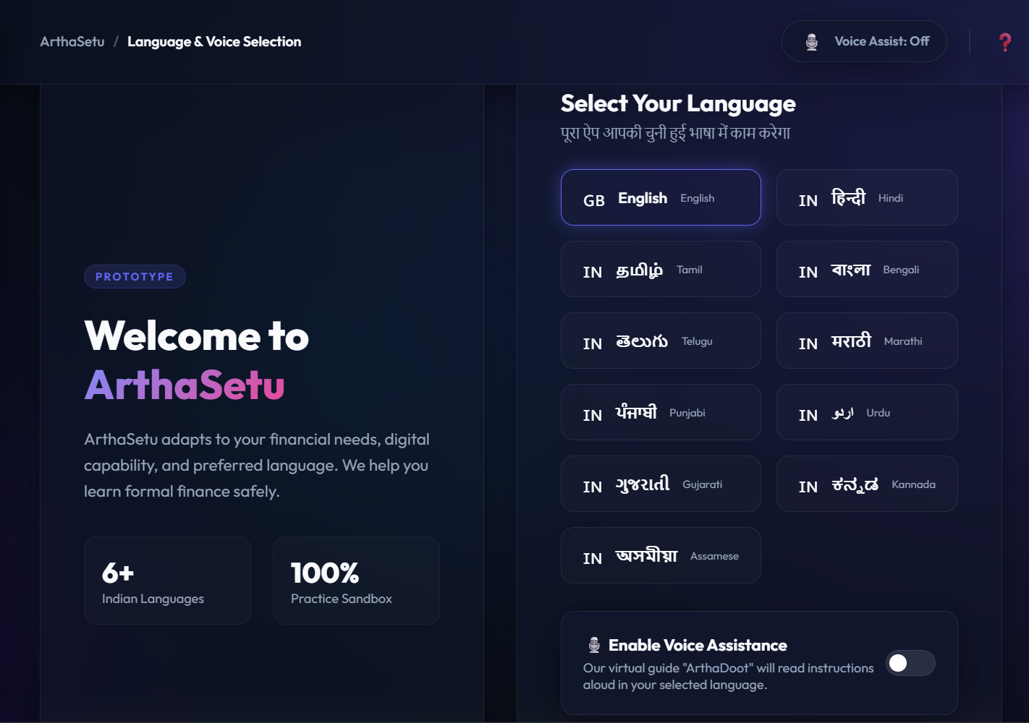
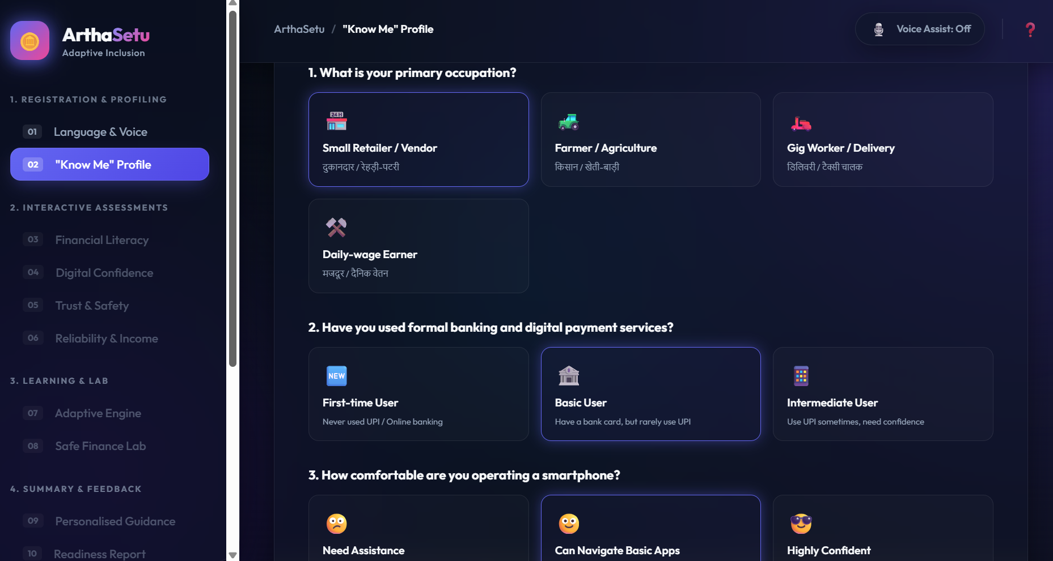
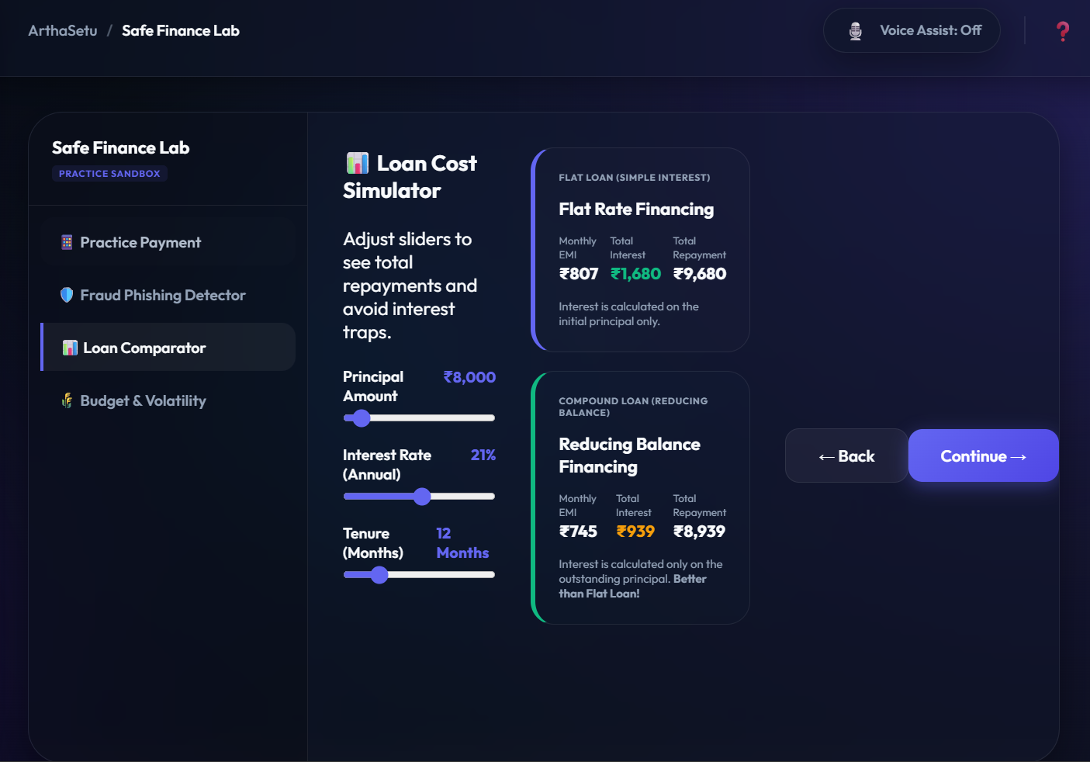
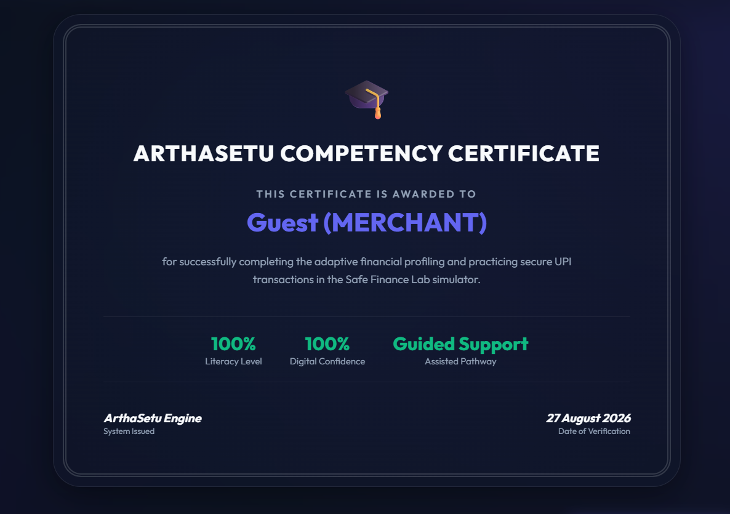
APPLICATION WALKTHROUGH
ArthaSetu — Live Prototype Screens
Step 2: "Know Me" Adaptive Profile
Step 1: Language & Voice Selection
Step 6: Safe Finance Lab — Loan Comparator
Step 7: Competency Certificate
ArthaSetu | Trust Scoring for Credit-Invisible Gig Workers | Smart India Hackathon 2026

Slide 5
DIFFERENTIATION & SECURITY
ArthaSetu vs Traditional Banking + 10-Layer Security
vs TRADITIONAL BANKING & UPI
10-LAYER SECURITY
Aspect | Banks / UPI | ArthaSetu
Target Users | Salaried, credit-scored | Gig workers, credit-invisible
Credit Assessment | CIBIL, payslips, ITR | Behavioral trust score (ML)
Language | English + Hindi (limited) | 6+ Indian languages, voice
Onboarding | KYC, Aadhaar, statements | Adaptive profiling, no docs
Security | TLS, passwords, OTP | ZKP + FHE + PQC (10 layers)
Privacy | Centralized storage | ZKP proofs, FHE compute
Training | None — real money at risk | 100% sandbox, zero risk
Audit Trail | Logs, changeable | Hash-chain, immutable, 7yr
🔮 ZKP
🧮 FHE
Prove without revealing — Halo2
Compute on encrypted data — BFV
🔐 PQC
⛓️ Hash-Chain Audit
Quantum-resistant crypto — Kyber-1024
Immutable logging — SHA3-256
🏰 TEE
✍️ Smart Consent
Secure enclaves — Intel SGX
Crypto consent tokens — Dilithium
🧠 Adaptive Risk
🌫️ Diff. Privacy
ML real-time scoring — 8 factors
Calibrated noise — ε=0.1
🔄 Crypto-Agility
🆔 Self-Sovereign ID
Credit-invisible workers get a trust score — no CIBIL, no payslips, no Aadhaar required.
Algorithm migration — 90-day keys
Decentralized identity — DID + VC
16 Tables: users · bank_accounts · consent_tokens · audit_immutable · fhe_computations · zkp_verifications · risk_assessments · ...
ArthaSetu | Trust Scoring for Credit-Invisible Gig Workers | Smart India Hackathon 2026

Slide 6
EVALUATION
Statistical Evaluation & Impact Assessment
CHAMPION MODEL: XGBoost
HYPOTHESIS TEST RESULTS
ROC-AUC
0.9999
χ²: Income ↔ Approval
847.3
REJECT H₀
Accuracy
99.5%
t-test: Credit Score ↔ Approval
t=45.6
REJECT H₀
Precision
99.6%
Recall
99.4%
χ²: Employment Type ↔ Approval
1203.1
REJECT H₀
F1-Score
0.995
χ²: Digital Literacy ↔ Approval
562.8
REJECT H₀
AFTER
BEFORE → AFTER EVALUATION FLOW
BEFORE
190M credit-invisible workers
ArthaSetu
• Trust Score (XGBoost)
• ZKP Identity
• FHE Scoring
• 10-Layer Security
• Sandbox UPI
• Multi-Language
Voice assistant and On-boarding Trust
No voice assistant and on-boarding trusts
Trust score → 99.5% accuracy
No formal credit history
→
→
ZKP verified — no data exposed
Excluded from UPI credit
FHE encrypted computation
Vulnerable to fraud
7yr immutable audit trail
No financial literacy tools
Zero real-money risk
ArthaSetu | Trust Scoring for Credit-Invisible Gig Workers | Smart India Hackathon 2026

